Slide 1
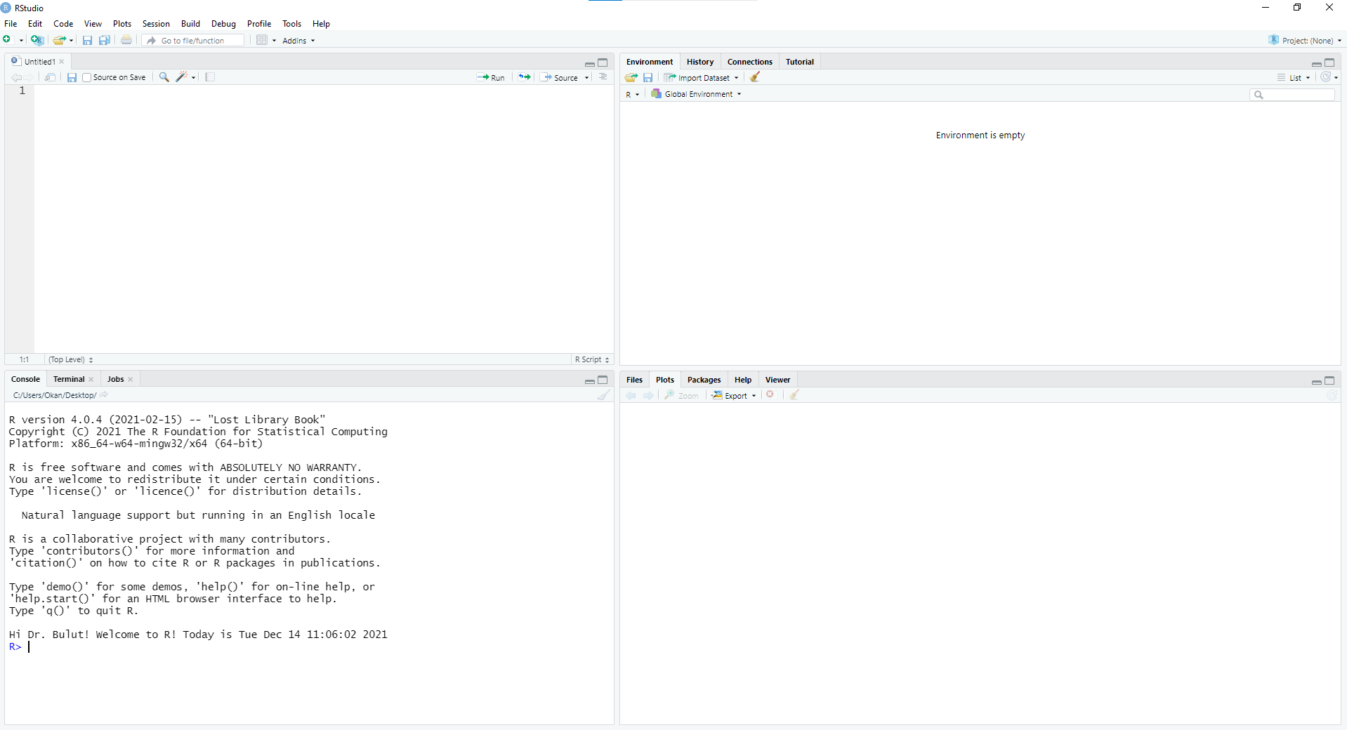
Source
This is where you create and save your script.
Source allows you to type your codes and send
them to the console. You can have multiple script
files open.
Work environment
This panel holds your objects (e.g., variables, datasets, etc.
that you create within an R session). You can also review
your R history using this panel.
Console
Console is where R executes your codes and displays
the output. You can use it to enter your R codes line
by line but it does NOT save your codes.
Miscellaneous
This panel the files in your working directory, plots/figures that
you created and help files that you want to see for each function
or package.

Slide 2
